Slide 1
Section 1.6 Transformations with Inverse Reflections

Slide 2
What is an Inverse Reflection?
An Inverse Reflection is a reflection over the line $y=x$ (diagonal line)
An arrow pointing “UP” will reflect over the line pointing “RIGHT”
An arrow pointing “DOWN” will reflect over the line pointing “LEFT”
An inverse reflection will switch the coordinates $(a,b) → (b,a)$
When graphing the inverse of a function, take several points of the original function.
Switch the coordinates. “X” cooridnates become “y” coordinates. “Y” coordinates become “x” coordinates. Map these new points and then connect the dots to draw the inverse.
y
y
5
5
4
4
3
3
2
2
1
x
1
x
-5
-4
-3
-2
-1
0
1
2
3
4
5
-5
-4
-3
-2
-1
0
1
2
3
4
5
-1
-1
-2
-2
-3
-3
-4
-4
-5
-5

Slide 3
Practice: Perform an inverse reflection on the graphs below
y
y
8
8
6
6
4
4
2
2
x
x
-8
-6
-4
-2
0
2
4
6
8
-8
-6
-4
-2
0
2
4
6
8
-2
-2
-4
-4
-6
-6
-8
-8

Slide 4
Notations for Inverse Reflections
There are two different notations for an inverse reflection:
Inverse Transformation:
Inverse Function:
The “x” and “y” variables are switched in the function. No need to isolate the “y” variable. Perform all horizontal transformations on the “x” variable. Perform all vertical transformations are onto the “y” variable
Switch the “x” and “y” variables. However, we need to isolate the “Y’ variable to get the INVERSE FUNCTION!
The next slide will explain to you what an inverse function is……..
VC by a factor of ½
HC by a factor of ½
HC by a factor of 1/3
VR and 2 UP
VE by 3 and then 12 units UP
HT 4 LEft

Slide 5
Practice: indicate the transformations for each of the following
Start With Inverse Reflection
V.C by ½
V.S of 1 unit UP
Start With Inverse Reflection
First: Move the 4 to the left and then factor
H.C by 1/3
H.S of 4/3 LEFT
Start With Inverse Reflection
V.S of 17 DOWN
H.C by 1/5
V.S of 22 units UP
Start With Inverse Reflection
First: factor the “1/2’ inside the brackets
V.C. by 2/3
H.E. by 2
H.S. of 14 RIGHT
V.S. of 131 DOWN

Slide 6
Transformations with Inverse Reflections
The inverse reflection can be performed first or last in the transformation process, whichever is easiest for you!
KEY: write your transformations out in steps, stay ORGANIZED!!
Do Inverse Reflection LAST!!
Also factor and isolate left side
Start With Inverse Reflection
Read the transformations from left to right
HS 4 LEFT VS 2 DOWN
V.C. by 1/2
H.C. by 1/3
HC by ½ and VC by 1/3
HS 2/3 LEFT
VS 2 DOWN
LAST STEP, INVERSE REFLECTION

Slide 7
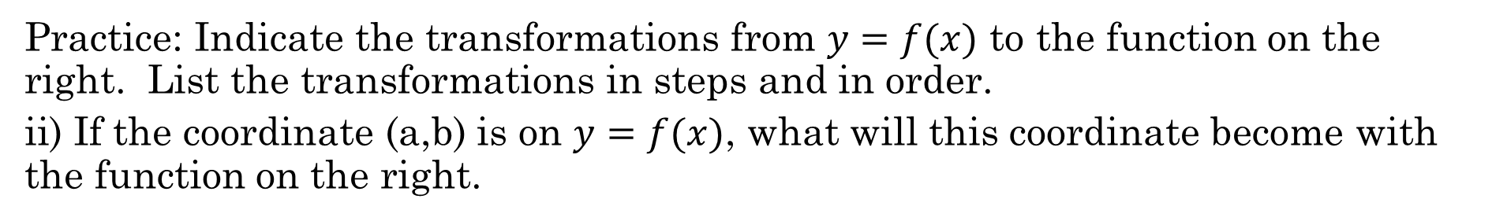
Practice: Indicate the transformations from $y=f(x)$ to the function on the right. List the transformations in steps and in order.
ii) If the coordinate (a,b) is on $y=f(x)$, what will this coordinate become with the function on the right.
First factor the coefficients of “x” and “y’
First factor the coefficients of “x” and “y’
Start With Inverse Reflection
Start With Inverse Reflection
HC by ½
VE by 3
HS of 3.5 LEFT
HC by 1/5
V.C by 1/2
H.S. of 2/5 LEFT
V.S of 2.5 UP
V.S of 4 DOWN

Slide 8
Ex: Given the graph of y = f(x), draw the graph of
y
8
6
4
2
x
-8
-6
-4
-2
0
2
4
6
8
-2
-4
-6
-8

Slide 9
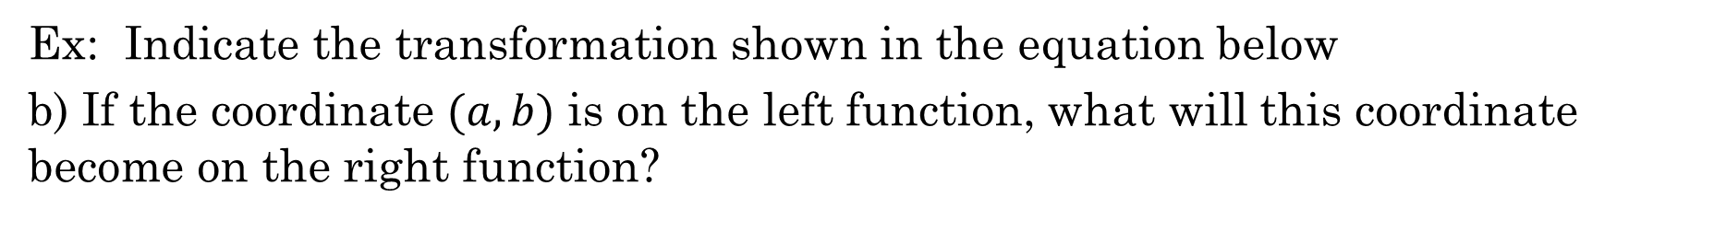
Ex: Indicate the transformation shown in the equation below
b) If the coordinate $(a, b)$ is on the left function, what will this coordinate become on the right function?
Can’t do a direct transformation when the equation is in inverse function form.
5. VE by 2
4. Inverse Transformation!
6. UP 1
Instead, convert the function back to y=f(x). This requires you to go backwards with transformations
Simplify your answer
1. DOWN 1
2. LEFT 2
3. HC by 1/3

Slide 10
Ex: Indicate the transformation shown in the equation below
b) If the coordinate $(a, b)$ is on the left function, what will this coordinate become on the right function?
5. VE by 2
Here are the key steps
Convert the original function to y=f(x)
Do the inverse transformation
Convert the inverse function to end equation on the right
6. 3 UP
4. Inverse Transformation!
7. HC by 1/2
1. DOWN 4
2. VC by 2/3
3. HC by 1/2
4. 3 LEFT

Slide 11
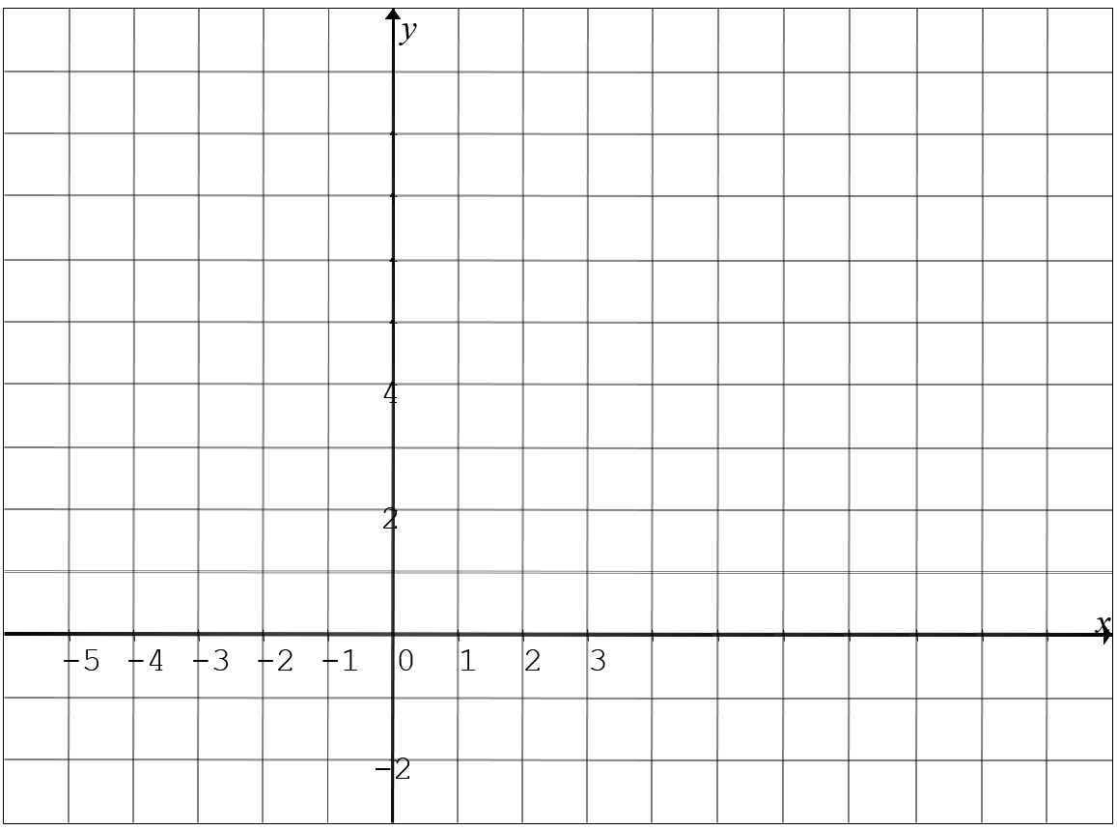
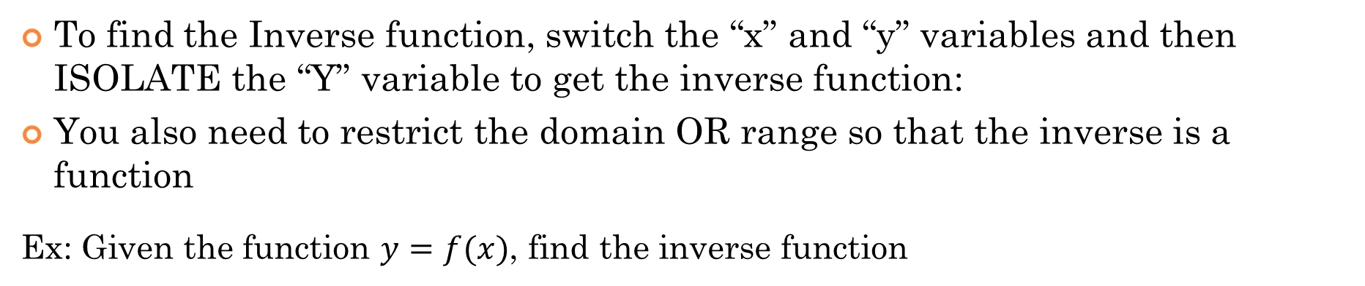

III) Finding the Inverse Function
To find the Inverse function, switch the “x” and “y” variables and then ISOLATE the “Y” variable to get the inverse function:
You also need to restrict the domain OR range so that the inverse is a function
Ex: Given the function $y=f(x)$, find the inverse function
$$y=x$$
The inverse is a parabola. We need to restrict our domain so it’s ONLY the RIGHT side of the parabola.

Slide 12
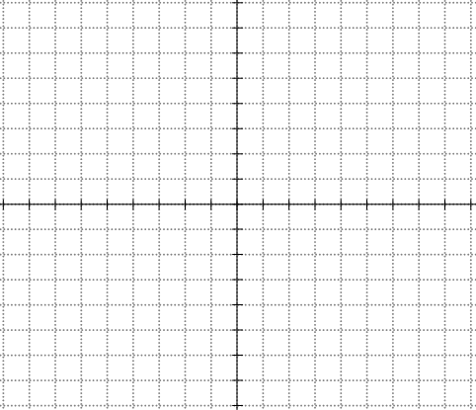
The Inverse of Quadratic Functions and ROOTS Functions
The inverse of a QF is not a function because it does not pass the vertical line test
So we must split the QF to two separate domains with the axis of symmetry. When the QF is broken into 2 parts, the inverse of each part will be a function
In contrast, the inverse of the top side of a radical function will be the RIGHT side of a parabola. So restrict the domain to the right side
We need to slip the parabola to LEFT and RIGHT sides and find each inverse separately
If we are finding the inverse of the Right side of a parabola, the inverse will be the top side
The inverse of the BOTTOM side of a radical function will be the LEFT side of a parabola. So restrict the domain to the LEFT side
If we are finding the inverse of the LEFT side of the parabola, the inverse will be the BOTTOM side
© Copyright all rights reserved to Homework depot: www.BCMath.ca

Slide 13
Find the inverse of the following function:
The inverse of the right side of the parabola will be the top:
Switch “x” and “y”
Square root both sides – plus or minus!
y
5
Since we are finding the inverse of the RIGHT side, the inverse will be the TOP side
4
3
2
1
x
-4
-3
-2
-1
0
1
2
3
4
5
6
7
-1
-2
-3
© Copyright all rights reserved to Homework depot: www.BCMath.ca
-4
-5

Slide 14
Practice: Find the inverse function :
Switch “x” and “y”
Isolate the “y” variable
Take the negative square root because the domain is on the left side
Since we are looking for the inverse of the “left” side of the parabola, the inverse function will be the “bottom” side of the root function
© Copyright all rights reserved to Homework depot: www.BCMath.ca

Slide 15
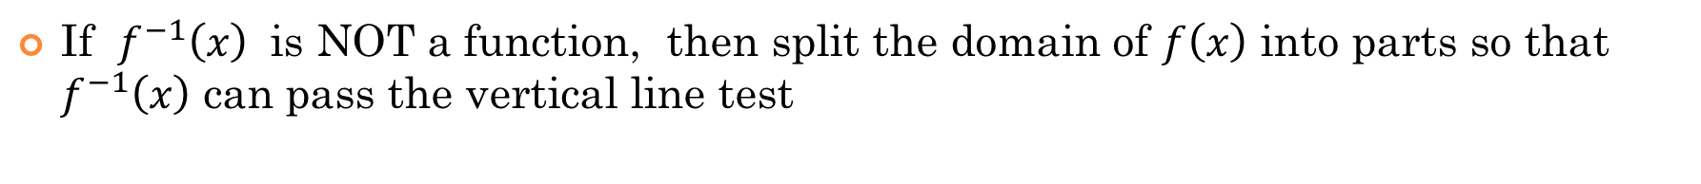
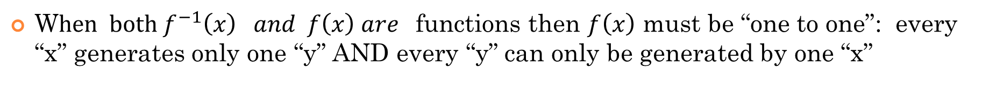
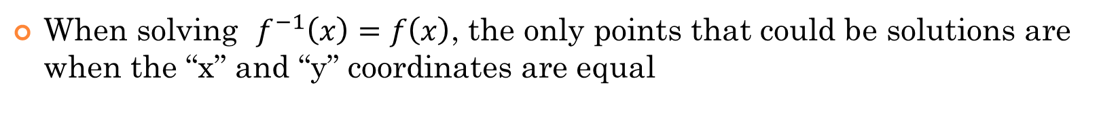
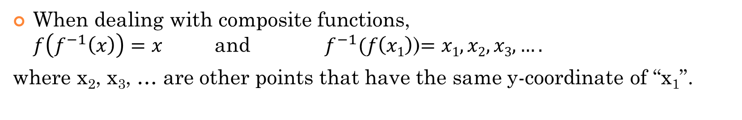
General Properties of Inverse Functions
If the point$\left(a,b\right) is on y=f\left(x\right), then f^{−1} (b)=a$
When dealing with composite functions, $f\left(f^{−1}\left(x\right)\right)=x$ and $f^{−1}(f\left(x1\right)$)$=x1, x2, x3,….$
where x₂, x₃, … are other points that have the same y-coordinate of “x₁”.
When solving $f^{−1}\left(x\right)=f\left(x\right)$, the only points that could be solutions are when the “x” and “y” coordinates are equal
W$hen both f^{−1}\left(x\right) and f\left(x\right) are$functions then $f\left(x\right)$ must be “one to one”: every “x” generates only one “y” AND every “y” can only be generated by one “x”
If $f^{−1}\left(x\right)$ is NOT a function, then split the domain of $f\left(x\right)$ into parts so that $f^{−1}\left(x\right)$ can pass the vertical line test

Slide 16
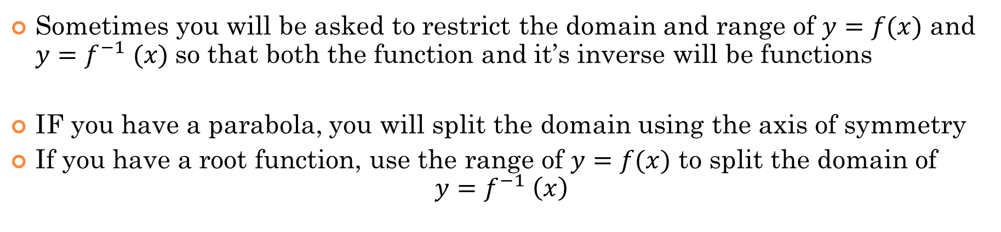
Domain and Range for Inverse Functions
Since we switch the x & y variables for the inverse reflection, the domain and range will also change
Sometimes you will be asked to restrict the domain and range of $y=f(x)$ and $y=f^{−1} (x)$so that both the function and it’s inverse will be functions
IF you have a parabola, you will split the domain using the axis of symmetry
If you have a root function, use the range of $y=f(x)$ to split the domain of $y=f^{−1} \left(x\right)$
If both $y=f \left(x\right) and y=f^{−1} (x)$ are function, then we don’t need to bother with restricting the domain and range
© Copyright All Rights Reserved Homework Depot www.BCMath.ca

Slide 17
Practice: Given each function, find the inverse function when the graph is reflected over $y=x$. State the domain of the inverse function
Since the inverse of a parabola is not a function, then we will need to restrict the domain so that the inverse will be a function
Split the domain using the axis of symmetry at
x=3

Slide 19
Ex: Given the graph of y = f(x), draw the graph of
y
8
6
4
2
x
-8
-6
-4
-2
0
2
4
6
8
-2
-4
-6
-8
© Copyright All Rights Reserved Homework Depot www.BCMath.ca

